Slide 1
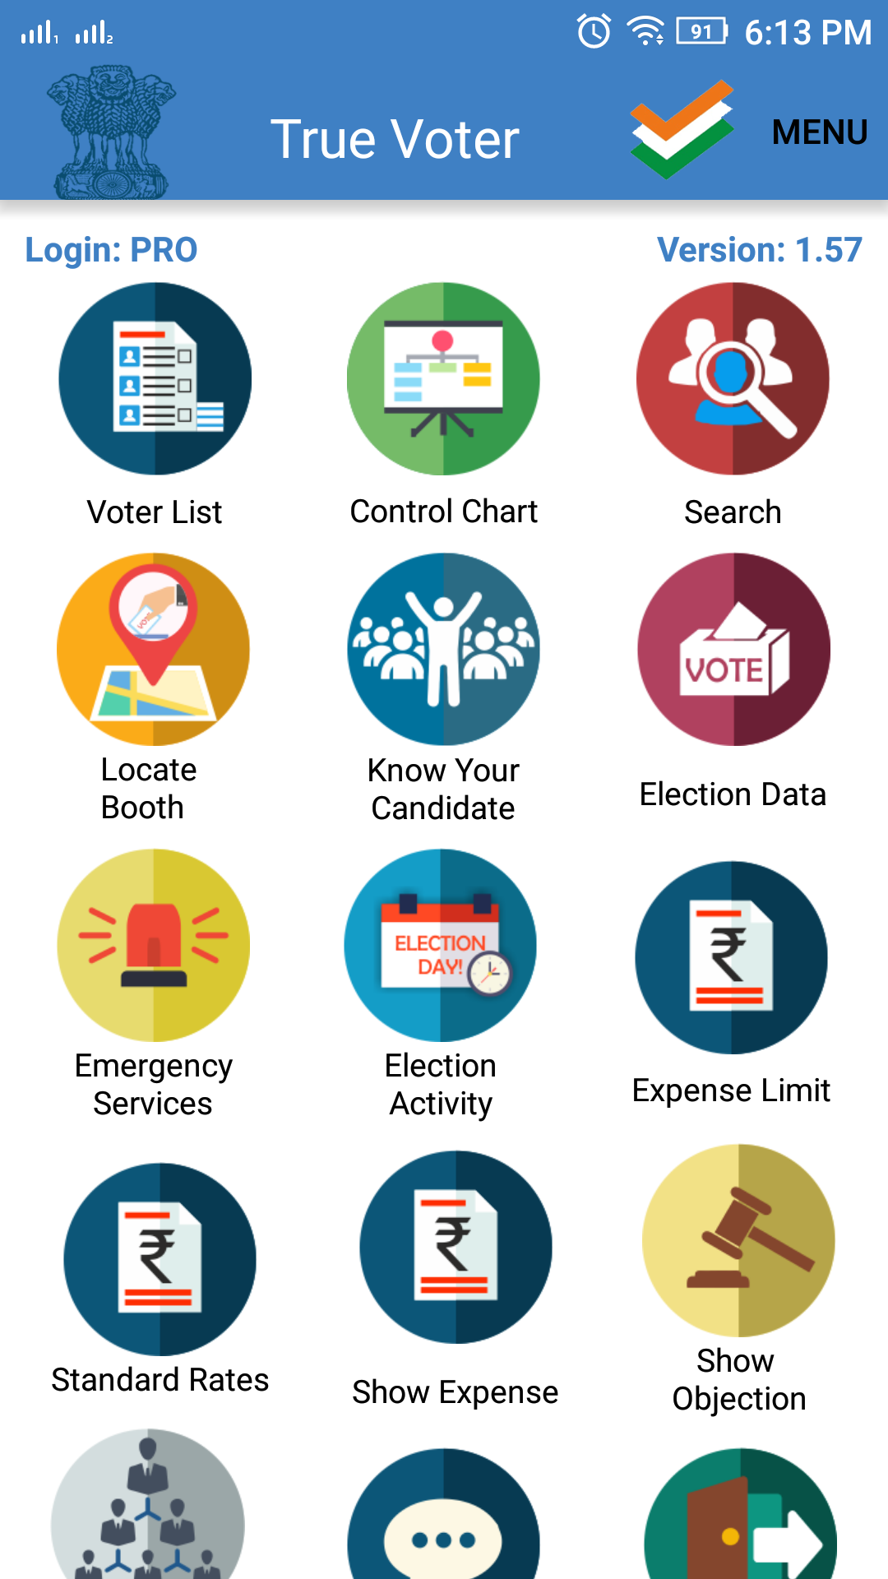
True Voter version 1.57
Election Data:-
This function is used to keep the records of polling data for voting.
In officer role only ‘PRO’, ‘PO1’, ‘PO2’, user can access this function.
At the time of App registration user have to select role as‘Booth Mapping Staff’.
Click on ‘Election Data’ button on the Home page of officer login

Slide 2
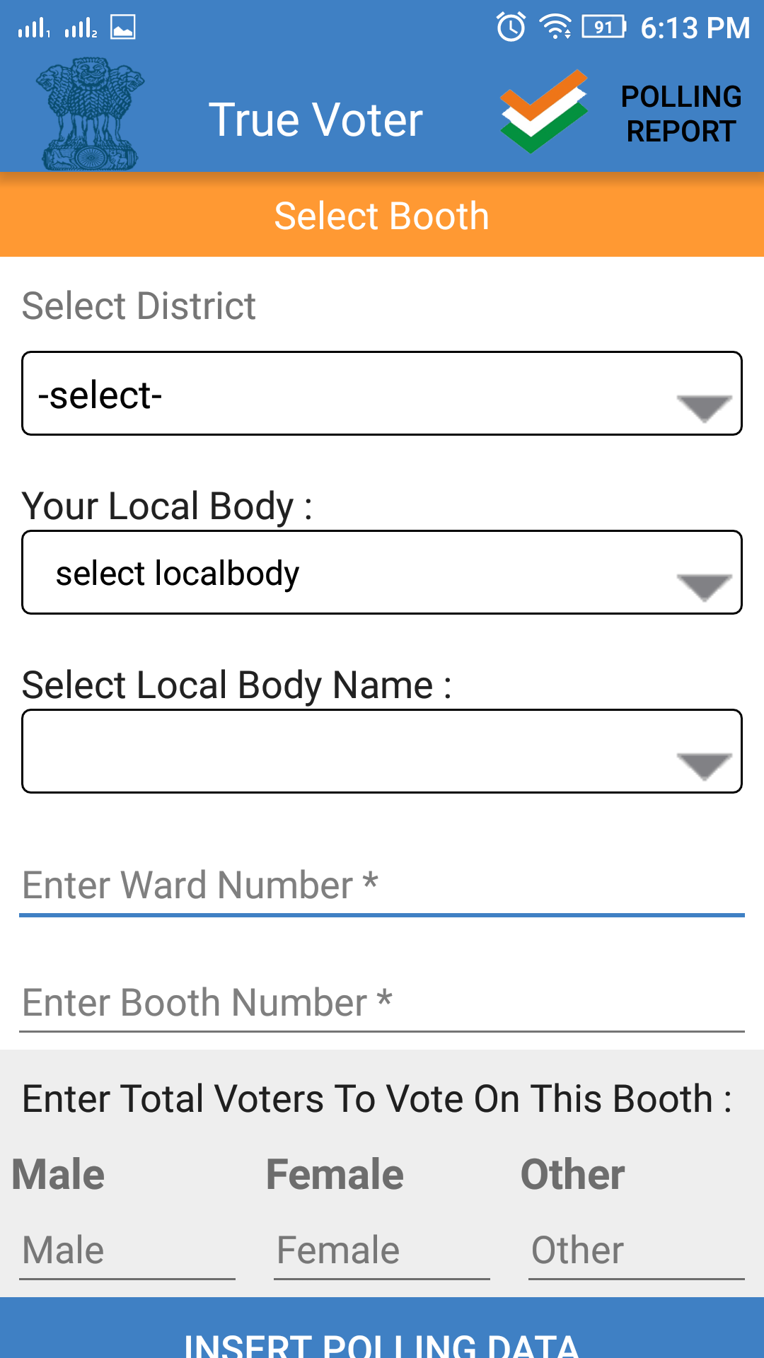
True Voter version 1.57
On the next page user have to select the details as given on the form.

Slide 3
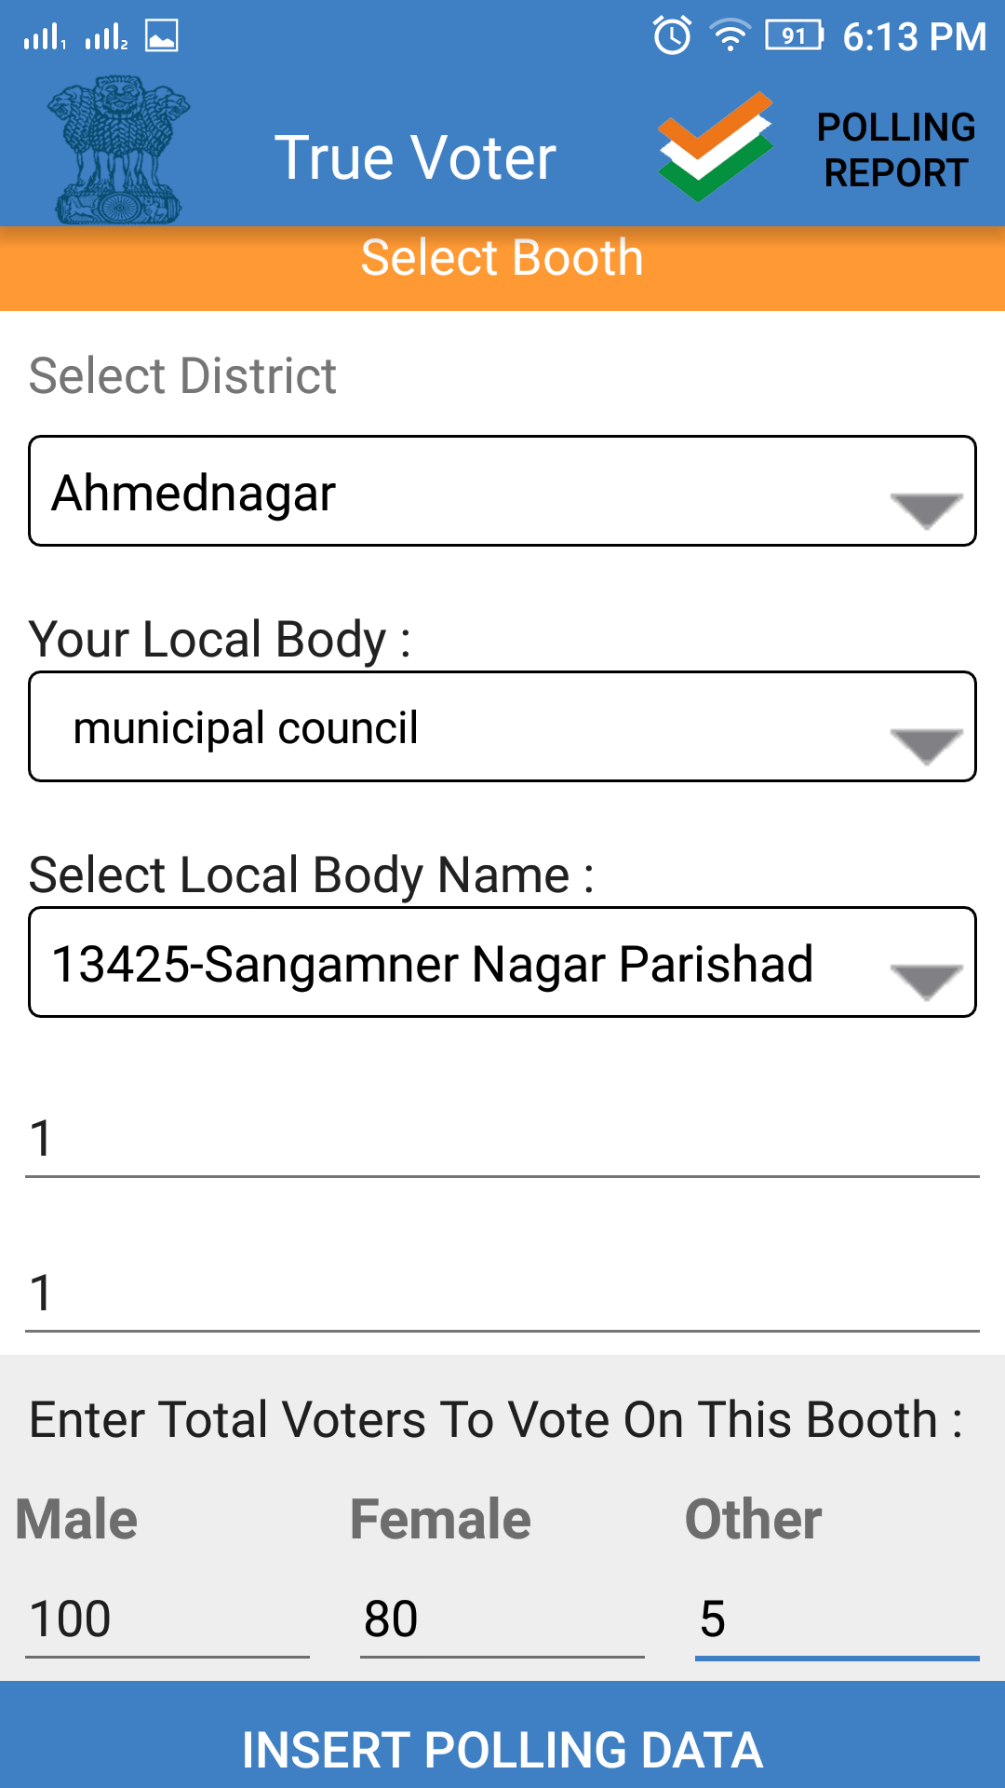
True Voter version 1.57
Select District name
Select Local body name
Select local body name for which user wants to enter election data.
Enter ward Number
Enter Booth Number
Enter Basic Data as
Total count of Male voters for selected booth.
Total count of Female voters for selected booth.
Total count of other voters for selected booth.
Click on ‘Insert Polling Data’ button

Slide 4
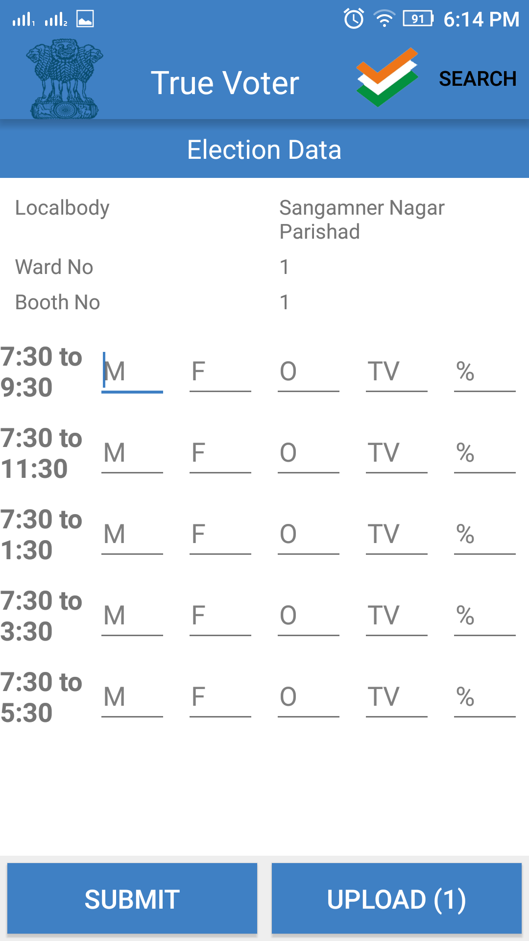
True Voter version 1.57
Election data page will be displayed to the user.
On this form user have to enter data for time interval of every two hours.
At M textbox- enter the count of male voters for two hours.
At F textbox- enter the count of female voters for two hours.
At O textbox- enter the count of other voters for two hours.
At TV textbox - User will display the total count of user entered data for two hours.
At % textbox - user will display the percentage of user entered data for two hours
Click on ‘Submit And Upload’ button
After successfull submit and upload User will display message that ‘Successfully upload’.

Slide 5
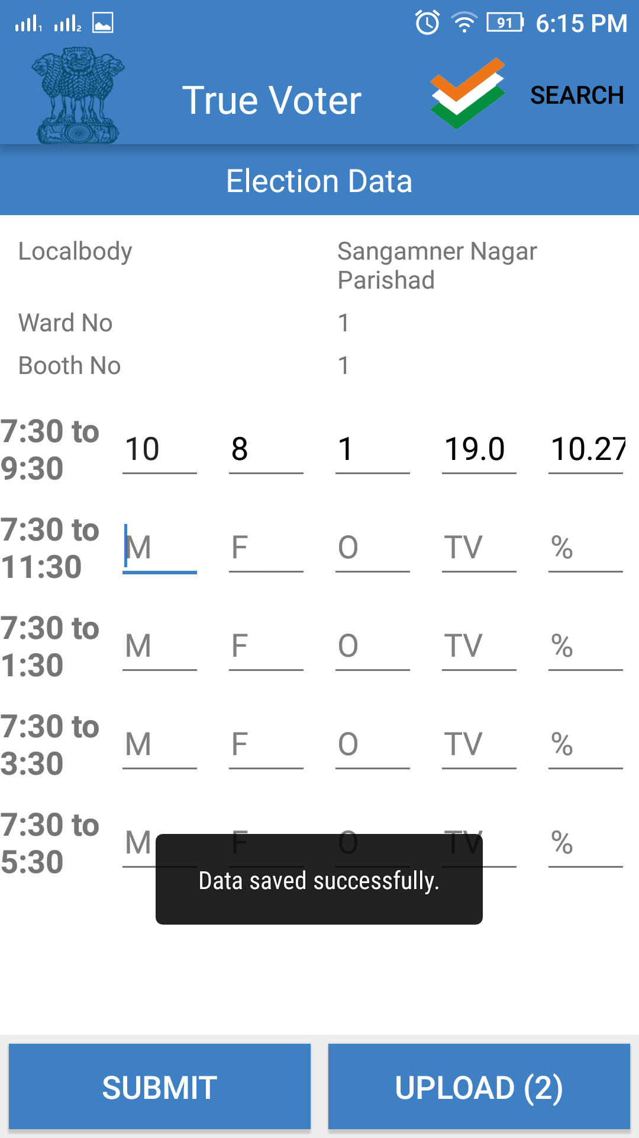
True Voter version 1.57
Enter data for voter count as shown in the screen shot.
Click on ‘Submit’ button to save record.
Click on ‘Upload’ button to upload data on the server.

Slide 6
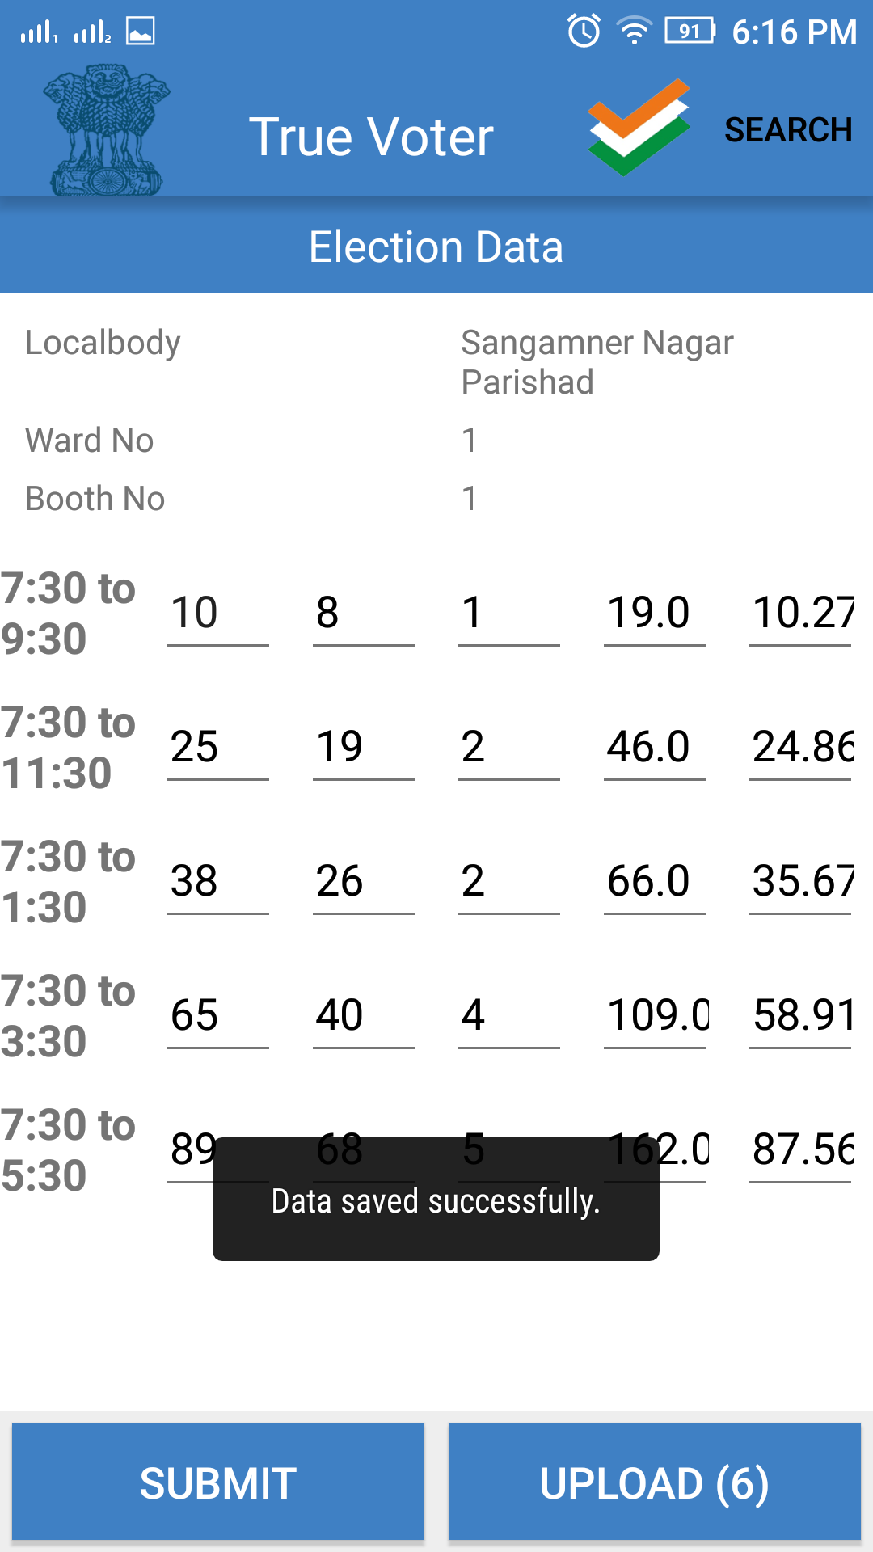
True Voter version 1.57
User have to enter data for every two hours voting.
User has to enter count form the start of voting.
As given in form enter count of first two hours i.e 7:30 to 09:30 infront of that time.
Enter data for first four hours infront of i.e 7:30 to 11:30 time.
After Every entry Click on Submit and Upload’ button to save data.
Follow this steps till the end of day of voting.

Slide 7
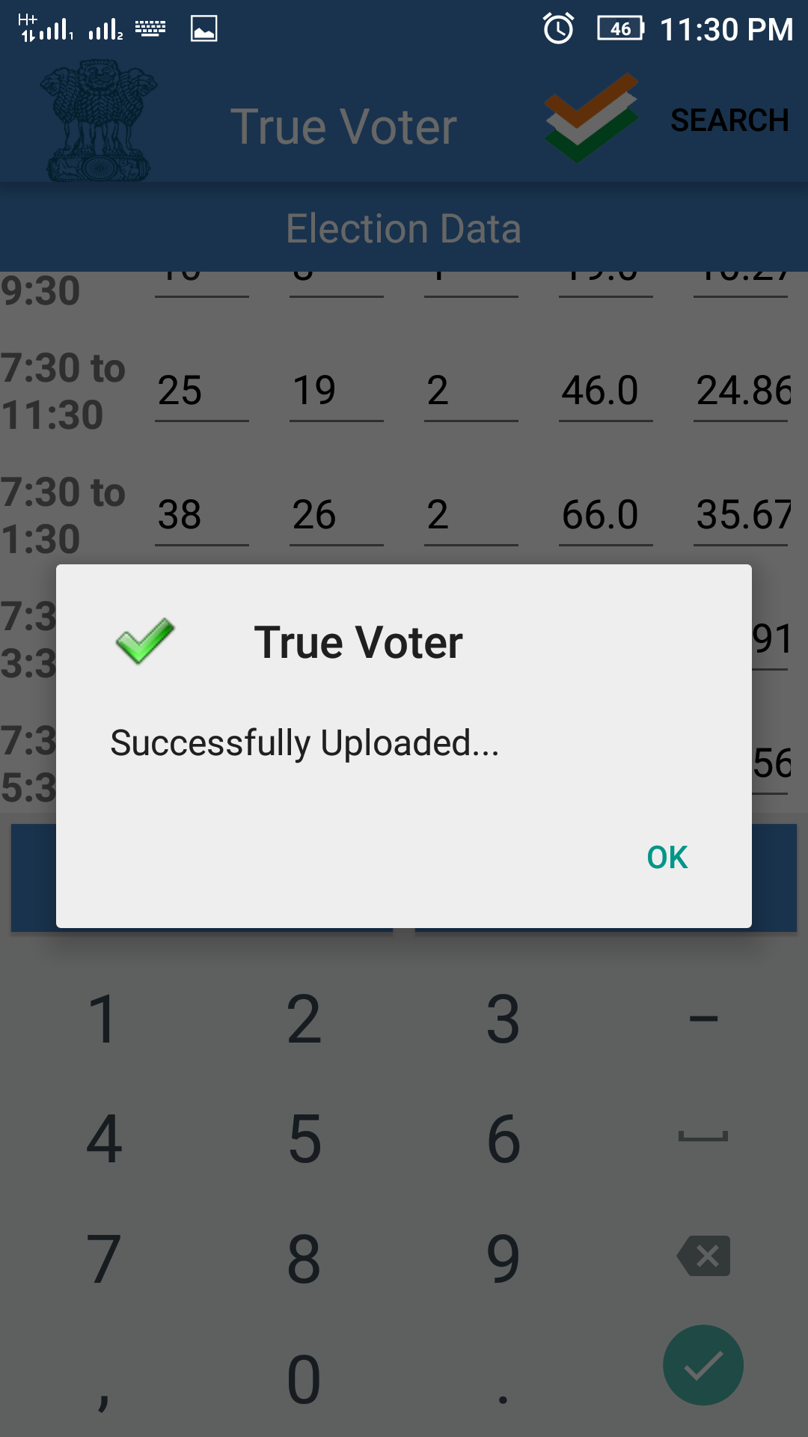
True Voter version 1.57
User should have to enter data carefully.
Once data get uploded it can not be updated.
When user click on ‘Upload’ button to upload data on the server.
After successfull submit and upload User will get message that ‘Successfully uploaded’.

Slide 8
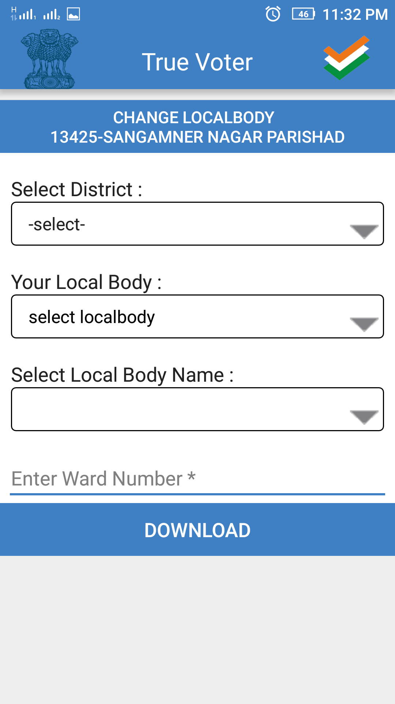
True Voter version 1.57
To view report for user election data. Click on the ‘Election Data’ on the home page.
User will be displayed this screen.
User have to enter the details given on this page.

Slide 9
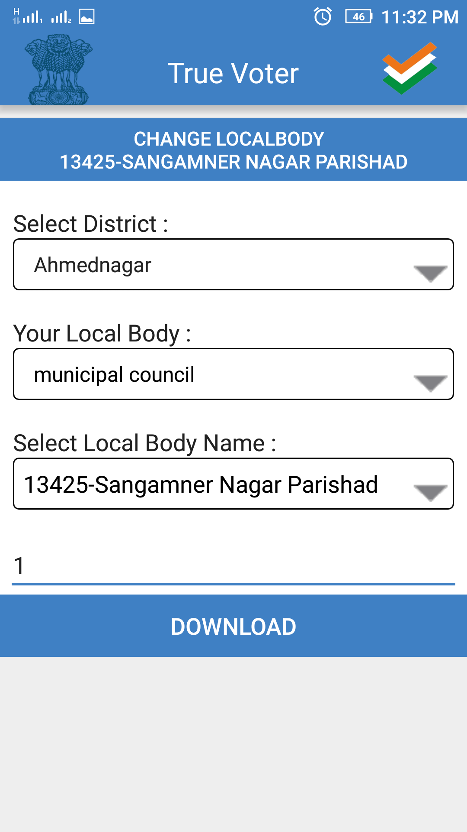
True Voter version 1.57
Select your District from given list.
Select your local body.
Select Local body name.
Enter Ward number.
Click on ‘Download’ button.

Slide 10
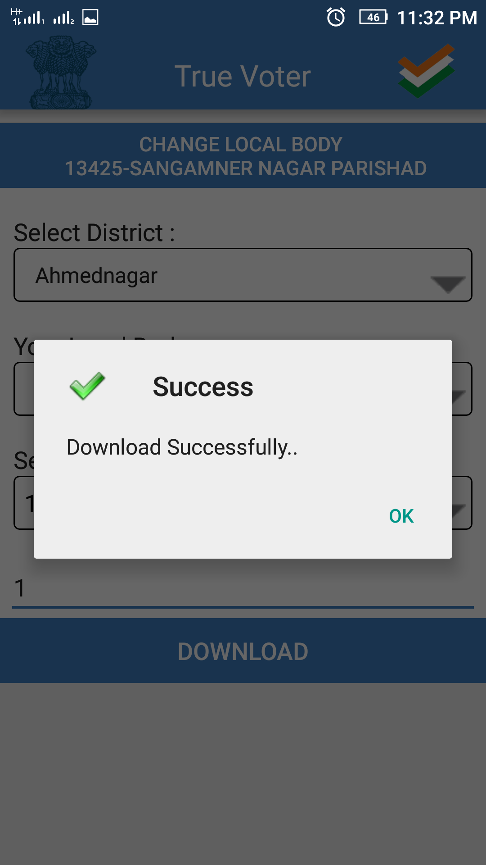
True Voter version 1.57
Election data for entered ward number will be download on users mobile.
After download complete user will be displayed message as ‘Download successfully.’

Slide 11
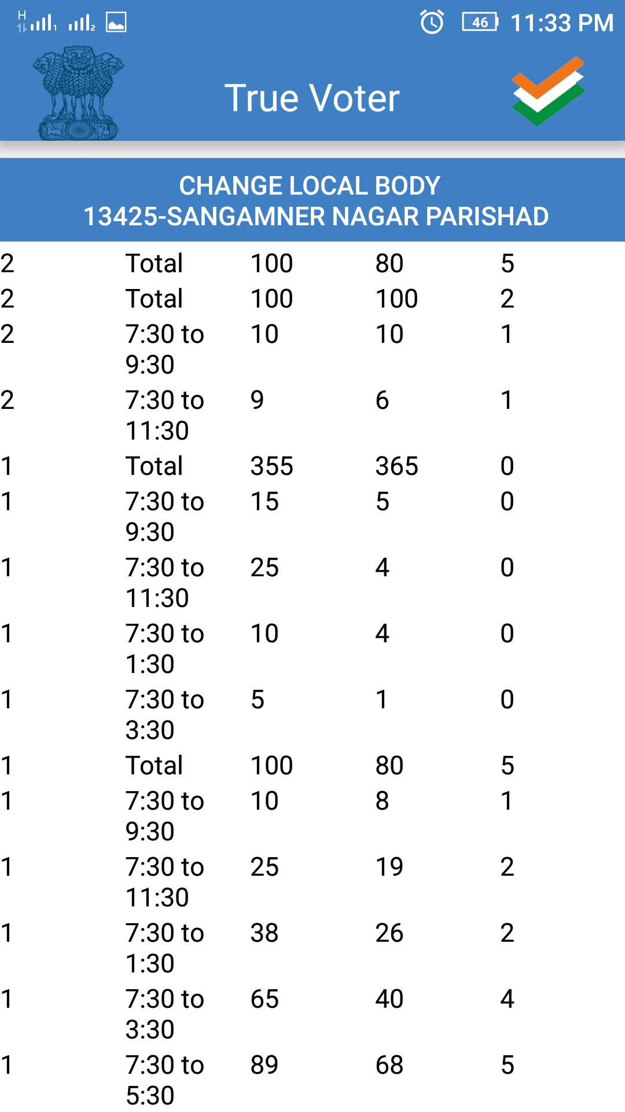
True Voter version 1.57
User will be displayed the report for the election data.

